Slide 1
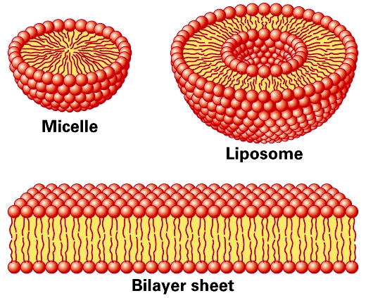
liposomes
The evolution of the science and technology of liposomes has been used in the development of drug carrier concept as a promising delivery System.
The liposome was adopted as a promising delivery system because its organized structure which could hold drugs, depending on their solubility characteristics, in both the aqueous and lipid phases.

Slide 2
What are lipids?
Lipids are a group of chemical compounds (such as oils and waxes) which occur in living organisms and are only sparingly soluble in water

Slide 3
What are phospholipids?
Phospholipids are a special group of lipids containing phosphate. Phospholipids are the building blocks of liposomes and cell membranes. Your skin, like the rest of your body, is composed of cells whose membranes must be healthy and strong in order for it to function properly.
Lipids in general are hydrophobic, also called non-polar (not able to be mixed in water). However, the phosphate group in phospholipids is hydrophilic, also called polar (able to be mixed in water).

Slide 4
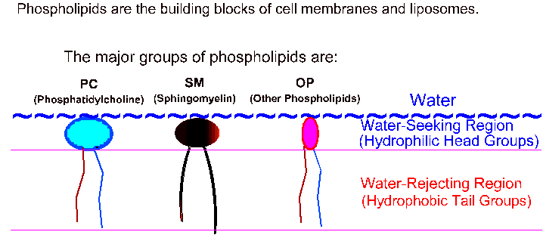

Slide 5
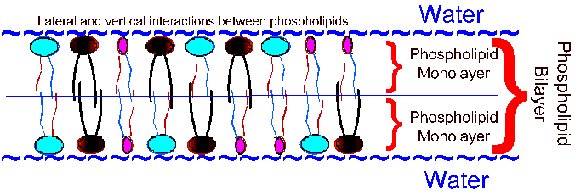
When phospholipids are immersed in water they arrange themselves so that their hydrophilic regions point toward the water and their hydrophobic regions point away from the water and stick together in bilayer form.
The interaction between phospholipids and water takes place at a temperature above the gel to liquid-crystalline phase transition temperature (TC) Which represents the melting point of the acyl chains.

Slide 6
When fully hydrated, most phospholipids exhibit
a phase change from L-β gel crystalline to the
L-α liquid crystalline state at TC.
All phospholipids have a characteristic (TC), which depends on nature of the polar head group and on length and degree of unsaturation of the acyl chains.
Above TC phospholipids are in the liquid-crystalline phase, characterized by an increased mobility the acyl chains.
Decrease in temperature below (TC) induces transition to a more rigid state (Gel State) resulting in tightly packed acyl chains and the lipid molecules arrange themselves to form closed planes of polar head groups.

Slide 7
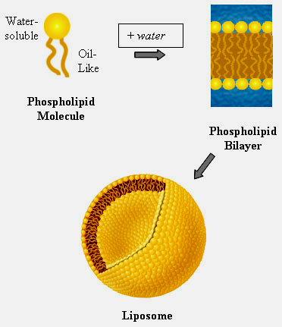
Liposomes can be formed from a variety of phospholipids. The lipid most widely used is phosphatidyl choline, phosphatidyl ethanolamime and phosphatidlyl serine either as such or in combination with other substance to vary liposome's physical, chemical and biological properties, liposome size, charge, drug loading capacity and permeability.
Cholesterol: Condense the packing of phospholipids in bilayer above TC. Thereby reducing their permeability to encapsulated compounds.
Stearylamine can be used to give positive charge to the liposomes surface.

Slide 8
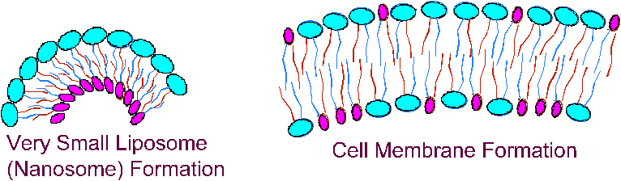
Phospholipid Bilayers are the core structure of liposome and cell membrane formations.
Thus the structure of liposomes is similar to the structure of cell membranes.
Liposome
Cell Membrane

Slide 9
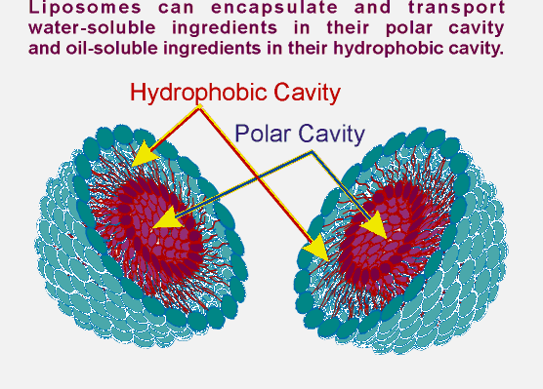
Liposomes can contain and mobilize water-soluble materials as well as oil-soluble materials in specific cavities inside themselves .

Slide 10
Morphology and Nomenclature of Liposomes
Multilamellar vesicles (MLV)
As water added to the lipid above this transition temperature (Tc), the polar head groups at the surface of the exposed amphiphile become hydrated and start to reorganize into the lamellar form.
The water diffuses through this surface bilayer causing the underlying lipid to undergo a similar rearrangement, and the process is repeated until all of the lipid is organized into a series of parallel lamellae, each separated from the next by a layer of water.

Slide 11
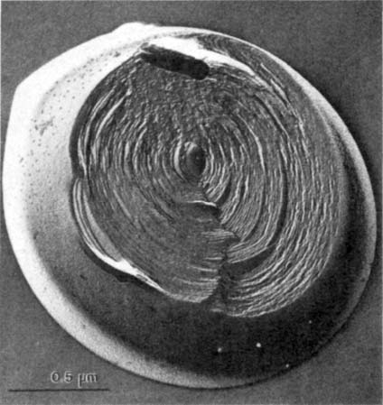
Mild agitation allows portions of close-packed, multilamellar lipid to break away resulting large spherical liposomes, each consisting of numerous concentric bilayers in close, alternating with layers of water, which are known as multilamellar vesicles (MLV).
These are heterogeneous in size,
varying from a few hundreds of
nanometers in diameter

Slide 12
Advantage of MLV:
They are simple to make and
have a relatively rugged construction.
Disadvantage of MLV:
The volume available for solute incorporation is limited
Their large size is a drawback for many medical applications requiring parenteral administration, because it leads to rapid clearance from the bloodstream by the cells of the RES.
On the other hand, this effect can be used for passive targeting of substances to the fixed macrophages of the liver and spleen.

Slide 13
Large unilamellar vesicles (LUV)
Vary in size from around100 nm up to tens of micrometers in diameter.
Advantages of Large unilamellar vesicles (LUV)
There is a large space for incorporation of "drug.“
Disadvantages of Large unilamellar vesicles (LUV)
they are more fragile than MLV and have increased
permeability to small solutes due to the absence of additional lamellae.

Slide 14
Small unilamellar vesicles (SUV)
The upper limit of size is designated as 100 nm.
Advantages of Small unilamellar vesicles (SUV)
Because of their small size, clearance from the systemic circulation is reduced, so they remain circulating for longer and thus have a better chance of exerting the desired therapeutic effect in tissues.
Disadvantages of small unilamellar vesicles (SUV)
The small size cause lower capacity for drug entrapment, less than 1% of the material available.

Slide 15

Liposome Function Depending on Size
Large Multiple-layer liposomes
Are liposomes within liposomes. They have a limited ability to penetrate narrow blood vessels or into the skin.
The materials that are entrapped in the inner layers of these liposomes are practically less releasable.

Slide 16
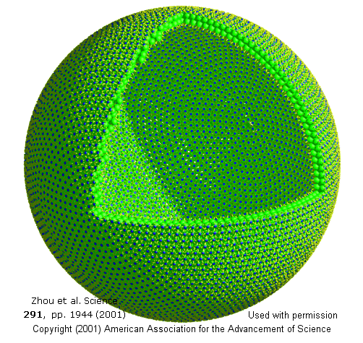
Large Unilamellar liposomes
Are easy to make by shaking phospholipids in water.
These liposomes have very limited functions and are usually made of commercial lecithin, commonly found in food products.
Commercial lecithin’s main function is as an emulsifying agent, improving the ability of oil and water to remain mixed.

Slide 17
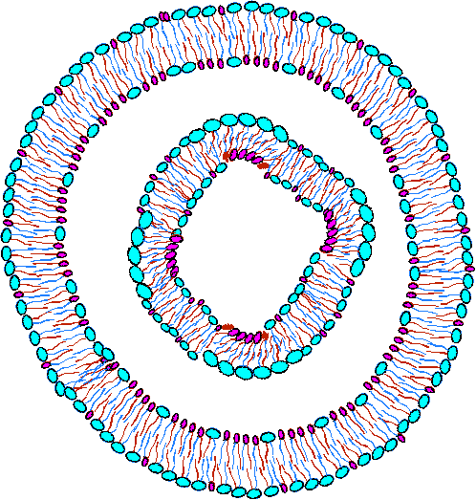
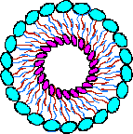
Small Unilamellar liposomes (Nanosomes)
Are constructed from the highest quality and high percentage of phosphatidylcholine (PC), one of the essential components of cell membranes .
Thus, nanosomes can easily penetrate into small blood vessels by intravenous injection; and into the skin by topical application.
Their entrapped material can be easily delivered to desired targets such as cells.

Slide 18
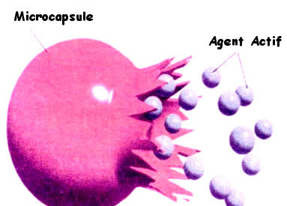
Rate of efflux:
1-The rate of efflux is decreased if cholesterol is incorporated into liquid crystalline bilayers, whereas is increased if it is incorporated, into bilayers in the gel crystalline state.
2-The nature of the phospholipid also alters the efflux rate with decreasing acyl chain length and degree of unsaturation causing an increase in the permeability of the bilayers.
3-Presence of charged phospholipids in the bilayer affect the efflux.

Slide 19
Application of liposome technology in drug delivery concept:
• Protection:
Where the active materials are protected by a membrane barrier from metabolism or degradation.
• Sustained release.
Such release is dependent on the ability to vary the permeability characteristics of the membrane by control of bilayer composition and lamellarity.
• Controlled release.
Drug release is enabled by utilizing lipid phase transitions in response to external triggers (activators) such as changes in temperature or pH.

Slide 20
• Targeted delivery.
The possibility of targeting compounds to specific cells or organs, such delivery can be achieved by:
Modifying on natural attributes (characteristics) such as liposome size and surface charge to effect passive delivery to body organs.
Incorporating antibodies or other ligands to aid delivery to specific cell types.
• Internalization.
This occurs by encouraging cellular uptake via endocytosis or fusion mechanisms, to deliver genetic materials into cells.

Slide 21
Several problems are associated with liposomes containing therapeutic agents:
Water-soluble drugs of low molecular weight leak into the circulating blood.
There was rapid interception of liposomes and their contents by the cells of the reticuloendothelial system (RES) through endocytosis, that limit the use of the system
The low levels of drug entrapment, vesicle size heterogeneity, and poor reproducibility and instability of formulations.

Slide 22
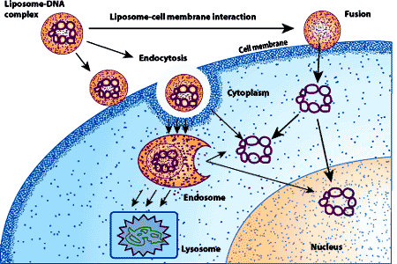



Liposomes can interact with cells by 5 different mechanims:
It is difficult to determine which mechanism is operative and more than one may operate at the same time.
Fusion
Endocytosis
Adsorption
Intermembrane
Transfer
Lipid Exchange
Contact
Release

Slide 23
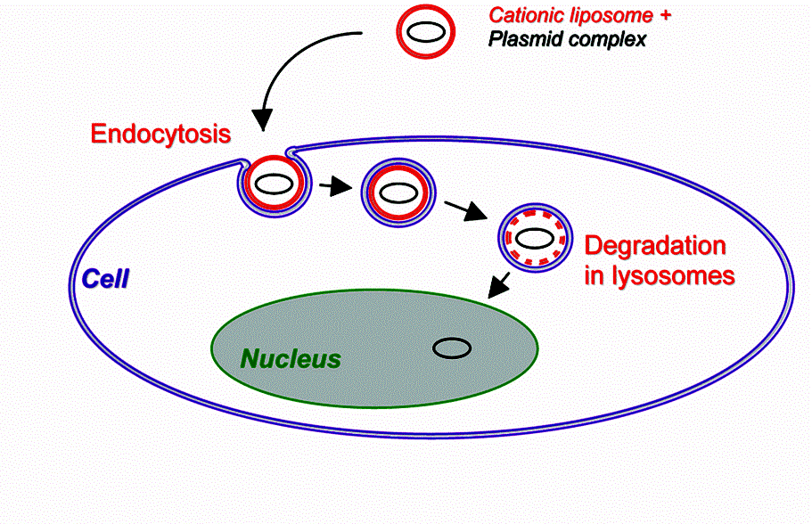
1) Endocytosis by phagocytic cells of the reticuloendothelial system such as macrophages and neutrophils, that makes the liposomal content available to the cell, where lisosomes break liposomes, and phospholipids hydrolysed to fatty acids which can be incorporated into host phospholipids.

Slide 24
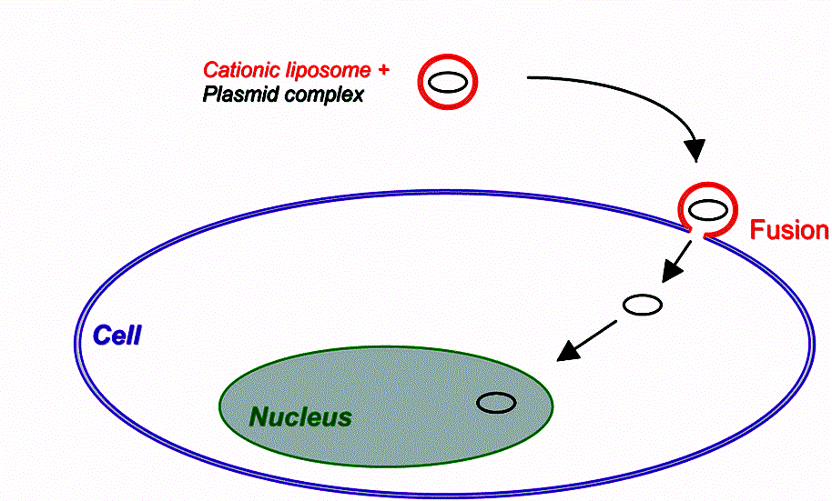
2) Fusion with the cell membrane by insertion of the lipid bilayer of the liposome into the cell membrane to become part of the cell wall, with simultaneous release of liposomal contents into the cytoplasm.

Slide 25
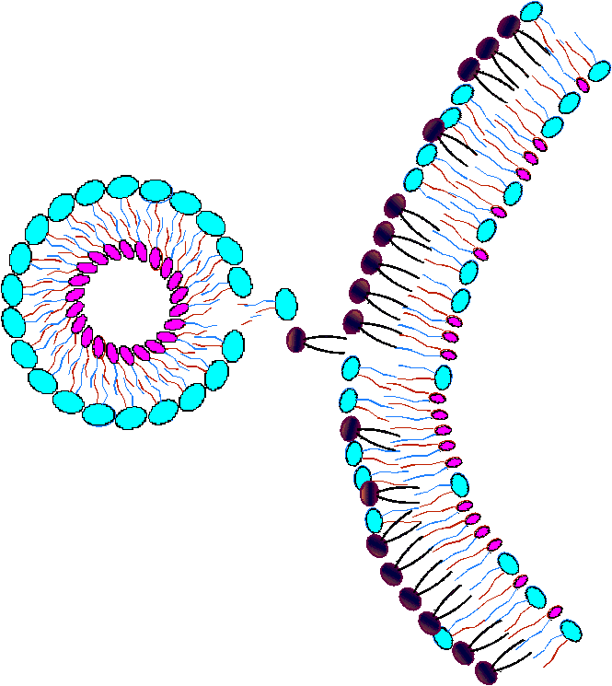
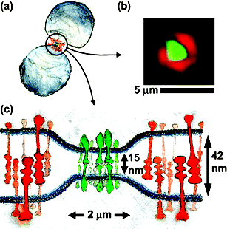
3) Adsorption to the cell surface either by nonspecific weak hydrophobic or electrostatic forces, or by interactions of specific receptors on cell surface to ligands on the vesicle membrane.
For water soluble components, vesicle contents are diffused through the lipids of the cell.
For lipid soluble components, vesicle contents are exchanged with the cellular membrane along with the lipid of the vesicle.

Slide 26
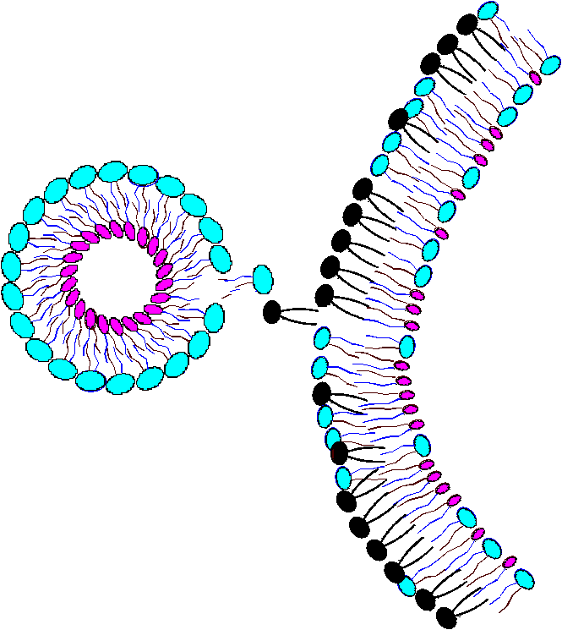
4) Inter-membrane Transfer:
With Transfer of liposomal lipids to cellular or subcellular membranes, or vice versa.

Slide 27
5) Contact-Release:
This case can occur when the membranes of the cell and that of liposomes exert perturbation (agitation) which increase the permeability of liposomal membrane, and exposure of solute molecule to be entrapped by cell membrane.

Slide 28
PREPARATION OF LIPOSOMES
The liposome methodology were aimed to good solute entrapment.
Numerous methods have been developed to meet different requirements.
These can be divided into two categories:
Those involving physical modification of existing bilayers Those involving generation of new bilayers by removal of a lipid solubilizing agent.

Slide 29
Multilamellar Vesicles
Physical Methods. Simple "Hand-Shaken" MLV.
MLV may be prepared from single-source natural or synthetic lipids, by suspending in a finely divided form in an aqueous solution maintained at a temperature greater than the Tc of the lipid.
For unsaturated phospholipids such as egg and soy phosphatidylcholine (PC), which have Tc values below O⁰C, this is conveniently done at room temperature.
Stirring speeds lipid hydration and liposome formation.
The possibility of lipid oxidation can be minimized by
working in an inert atmosphere of nitrogen or argon.

Slide 30
As the liposomes form, a small proportion of the solution and its associated solute becomes entrapped within the interlamellar spaces.
Two hours of gentle stirring is normally adequate to achieve near-maximal incorporation.
At the end of this period, the loaded liposomes can be separated from nonencapsulated solute using a process such as centrifugation or dialysis.
It is often desirable to prepare liposomes from mixtures
of amphiphile to improve their stability or to impart functional properties such as charge.

Slide 31
In this case it is essential that the different lipids be thoroughly mixed at the molecular level.
This can be achieved by dissolving them in a common solvent such as a 2:1 (v/v) mixture of chloroform and methanol and then removing the solvent.
This can be done using a rotary evaporator, where the lipid can be deposited as a thin film, which aids solvent removal and subsequent dispersion of the lipid.

Slide 32
Thin film hydration method
for preparation of liposome
using rotary evaporator

Slide 33
The disadvantages of this method is their low efficiency
for incorporation of water-soluble solutes, which is due to the fact that much of the volume is occupied by the internal lamellae and that the multilayers formed and sealed off with the majority of the lipid never having come into contact with the solute.
Thus, in neutral liposomes, only a few percent of the starting material may become entrapped.

Slide 34
The encapsulation efficiency can be increased by inclusion of a charged amphiphile, such as phosphatidyl glycerol or phosphatidic acid at a molar ratio of 10-20%, causes electrostatic repulsion between adjacent bilayers, leading to increased interlamellar separation, thus allowing more solute to be accommodated.
However, if the solute itself is charged, entrapment may be increased or decreased depending on the relative sign

Slide 35
Dehydration/Rehydration Vesicles (DRV).
The DRV method was designed to achieve high levels of entrapment.
The intention of the DRV method is to maximize exposure
of solute to the lipid before its final lamellar configuration
has been fixed, so that the liposomes ultimately form
around the solute.

Slide 36
This can be achieved by first preparing MLV in distilled water and then converting these to SUV so that the phospholipid achieves the highest possible level of dispersion within an aqueous phase.
Thus when SUV are mixed with a solution of the material to be entrapped the majority of the amphiphile is directly exposed to the solute.
Then, water is removed by freeze-drying, when a small amount of water is added with a large osmotic gradient between the internal and external phases leading to hyperosmotic inflation.

Slide 37
The vesicles will fused surrounding the active ingredient with the formation of larger liposomes, which now encapsulate a large proportion of the solute with encapsulation efficiencies 40-50%.
Following the hydration step, the liposomes are diluted with an isotonic buffer such as phosphate-buffered saline and washed to remove nonencapsulated material
using a process such as centrifugation or dialysis.

Slide 38
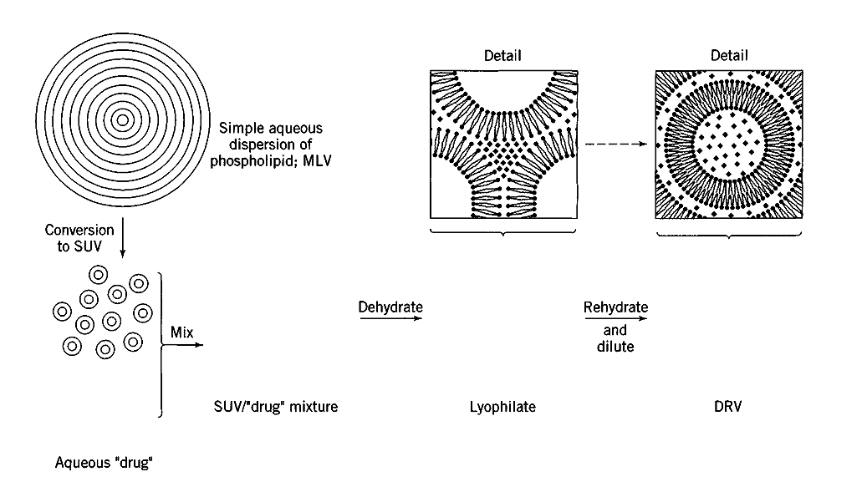
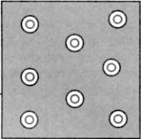
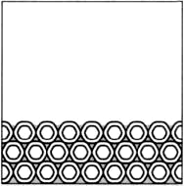
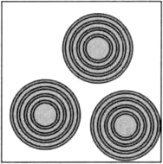

Steps for the manufacture of liposomes by the dehydration-rehydration method.

Slide 39
Resizing of Liposomes.
For some applications, the large size and size heterogeneity of multilamellar liposomes is a disadvantage.
Both parameters can be reduced by various physical processes that result in the formation of reduced size multilamellar or unilamellar liposomes.
Sonication and membrane extrusion have been used.
membrane extrusion have been used to reduce the size range of DRV while still retaining large proportions of the encapsulated solutes.

Slide 40
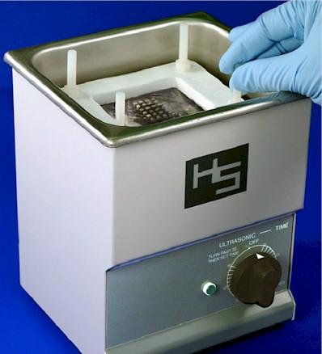
Small Unilamellar Vesicles
Preparing SUV by sizing use ultrasonic irradiation
Most of the commonly used methods for preparing SUV
involve size-reduction of preexisting bilayers using ultrasonic irradiation by high-power probe sonication for seconds, in an inert atmosphere to prevent oxidative and by using a cooling bath to dissipate the large amounts of heat produced.
A more gentle approach is to use bath sonication,

Slide 41
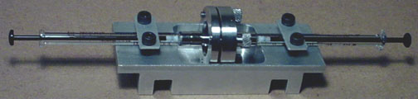
Preparing SUV by sizing use high pressure extrusion.
High-pressure extrusion involves forcing multilamellar
liposomes at high pressure through membranes having
"straight-through," defined size pores.
The liposomes have to deform to pass through the small pores, as a result of which lamellar fragments break away and reseal to form small vesicles of similar diameter to that of the pore.

Slide 42
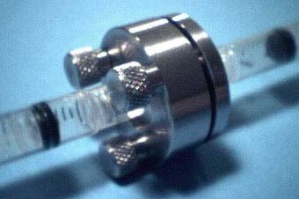
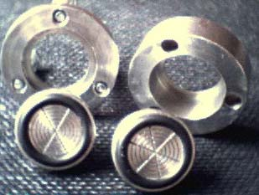
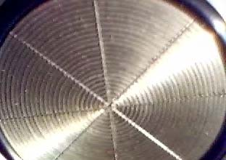
Repeated cycling through small-diameter pores at temperatures greater than the Tc of the lipid produces a homogeneous SUV.
Advantage of the High-pressure extrusion method is that the disruptive effects of sonication are avoided.
Liposome Extruders

Slide 43
Large Unilamellar Vesicles
LUV’s single bilayer membrane (10-20 μm) makes them well suited as model membrane systems whereas the large internal aqueous volume : lipid mass ratio means maximized efficiency of drug encapsulation.
Methods for preparing LUV fall into two categories:
The first involving generation of new bilayers by removal of a lipid solubilizing agent,
The second involves physical modification of preformed bilayers.

Slide 44
For LUV preparation
The solubilizing agents include detergents.
The lipid is initially dissolved by an aqueous solution of the detergent to form mixed lipid-detergent micelles, and the detergent is then removed by dialysis or gel chromatography.
Ionic detergents, such as cholate and deoxycholate or nonionic detergents such as Triton X 100 and have been used.
Detergent removal methods are used for functional reconstitution of membrane proteins that is better in the presence of the nonionic detergents.

Slide 45
Removal of Organic Solvents.
Solvent vaporization liposomes tend to be of a larger size range than those prepared by detergent removal.
Three distinct types of process have been described, each involving addition of a solution
of lipid in organic solvent, to an aqueous solution of the
material to be encapsulated.
Solvent Infusion
Reverse Phase Evaporation.

Slide 46
Solvent Infusion.
Solvent such as diethyl ether, petroleum ether, ethylmethyl ether, or diehlorofluoromethane containing dissolved lipid(s), is infused slowly into the aqueous phase, which is maintained at a temperature above the boiling point of the solvent so that bubbles are formed.
The lipid is deposited as unimellar liposomes.
High encapsulation efficiencies (up to 46%) were reported
The major disadvantage is the need for exposure of the active ingredient to organic solvents, with the damage to labile materials such as proteins.

Slide 47
Reverse Phase Evaporation.
Formation of a water-in-oil (diethyl ether)
emulsion containing excess lipid.
When all of the solvent has been removed (by rotary evaporation), there is just enough lipid to form
a monolayer around each of the microdroplets of aqueous
phase.
In the absence of cholesterol, these unilamellar vesicles have diameters in the range of 0.05-0.5 μm, while with 50 mol % cholesterol, mean diameters are about 0.5 μm.
High encapsulation efficiencies of up 65% using hydrophilic solutes.

Slide 48
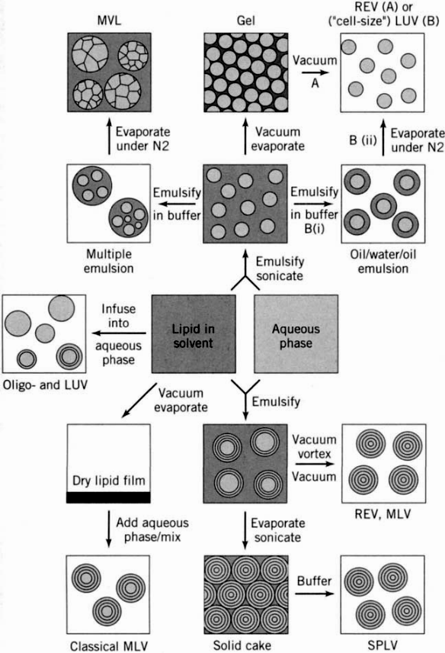

Slide 49
REMOVAL OF UNBOUND DRUG
When lipophilic drugs of appropriate structure are associated with liposonics by inclusion in the bilayer phase, the degree of "encapsulation" is dependent upon the saturation of the lipid phase with degrees of encapsulation of over 90%. Thus it is unnecessary to remove the unbound drug.
However, in the case of water-soluble drugs, the encapsulated drug is only a fraction of the total drug used. Thus, it is required to remove the unbound drug from the drug-loaded liposomes in dispersion.

Slide 50
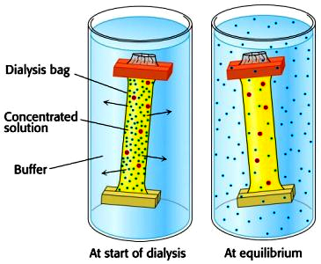
A. Dialysis
Dialysis is the simplest procedure used for the removal of the unbound drug, except when macromolecular compounds are involved.
Advantages:
Dialysis Technique requiring no complicated or expensive equipment.
Dialysis is effective in removing nearly all of the free drug with a sufficient number of changes of the dialyzing medium.
Liposome dispersion

Slide 51
Disadvantages:
Dialysis is a slow process.
Removal of over 95% of the free drug require a minimum of 3 changes of the external medium over 10 to 24 hr at room temperature.
Care is taken to balance the osmotic strengths of the liposomal dispersion and the dialyzing medium to avoid leakage of the encapsulated drug.

Slide 52
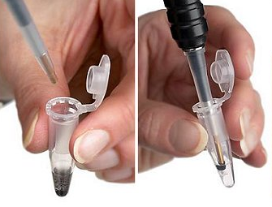
B. Centrifugation
Centrifugation is an effective means of isolating liposomes from the free drug in the suspending medium.
Two or more resuspension and centrifugation steps are included to effect a complete removal of the free drug.
The centrifugal force required to pull liposomes down into a pellet is dependent upon the size of the liposomes.

Slide 53
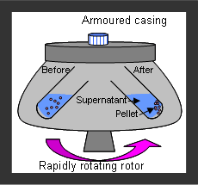
Disadvantages:
The use of refrigerated centrifuges operating at high speeds is energy intensive and expensive.
It is essential to ensure that the osmotic strength of the resuspending medium is matched with that of original liposomal dispersion in order to avoid osmotic shock and rupture of liposomes.

Slide 54
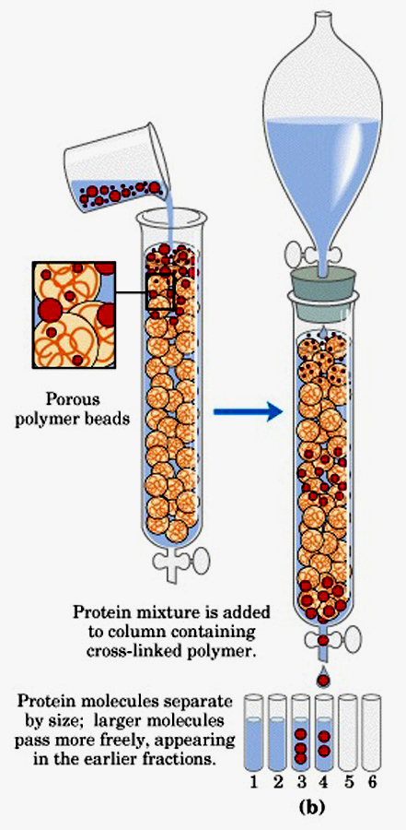
C. Gel Filtration
Gel permeation chromatographic technique is used extensively both to separate liposomes from unbound drug and also to fractionate heterogeneous liposomal dispersions.
Advantages:
The technique is very effective and rapid at the laboraton level.

Slide 55
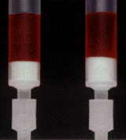
Disadvantages:
Gel filtration is expensive.
Dilution of the liposomal dispersion with the eluting medium may necessitate another concentration step.
Lipid losses on the column materials.

Slide 56
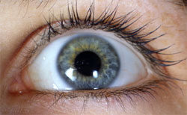
Pharmaceutical Application of Liposomes
OPHTHALMIC
Liposomes improve bioavailability of ophthalmic drugs after topical application due to lipophilisation of water soluble drugs which can not penetrate the lipophilic cornea.
The effect of liposomes in ocular drug delivery is limited by
their rapid clearance from the precorneal area, especially in for neutral liposomes and negatively charged liposomes. Positively charged liposomes exhibit a prolonged precorneal retention, due to electrostatic interaction with the negatively charged corneal epithelium with increase the residence time and enhance drug absorption.

Slide 57
DERMATOLOGICAL APPLICATION
As dermatological and cosmetic preparations have increased percentages of active ingredients. This cause the problem of increasing level of active ingredients in the wrong
layers of the skin resulting in irritation and high systemic absorption.

Slide 58
The resolution of this problem is to coat the active ingredients so that they can be absorbed through the top layer into the lower layers of the skin where they form a ceramic layer with negligible systemic absorption.
Due to the rigidity owing to the cholesterol content, liposome delivers active ingredients to the specific layers of the skin, increasing the concentration of those actives in the dermis, and then providing a prolonged time-release action throughout the entire day with minimum systemic absorption.

Slide 59
PARENTRAL APPLICATION
The closed pack of liposome structure can encapsulate aqueous soluble drugs within the central aqueous compartment or lipid soluble drugs within the bilayer membrane.
The encapsulation of drugs with liposomes alters drug pharmacokinetics, and may be exploited to achieve targeted therapies by the flexibility in alteration of the liposome surface.

Slide 60
Applications as parentral dosage form
Passive tumour targeting Vaccine adjuvants Passive targeting to lung endothelium in gene delivery Targeting to regional lymph nodes Targeting to cell surface ligands in various organs/areas of pathology Sustained release depot at point of injection

Slide 61
THANKS

